Slide 1
A Distributed Graph Engine for web scale RDF data
Peiqin Gu
10/28/2013

Slide 2
Paper Info
A Distributed Graph Engine for Web Scale RDF Data
UCLA, Columbia University, Microsoft Research Asia, Renmin University of China
VLDB 2013
12 pages

Slide 3
Motivation
Much work has been devoted to supporting RDF data, but the state-of-the-art systems and methods still cannot handle web scale RDF data effectively.
Many useful and general purpose graph-based operations (e.g. random walk, reachability, community discovery) on RDF data are not supported, as most existing systems store and index data in particular ways to maximize SPARQL query processing.

Slide 4
Challenges
RDF data management systems are facing two challenges, namely systems’ scalability and generality.
Scalability
Scalability remains the biggest hurdle. Most approaches model RDF data as a set of triples, and use RDBMS for storing, indexing, and query processing, while processing a query often involves a large number of join operations.
Brute-force approach fails in the face of complex SPARQL queries (e.g. queries with a multi-hop chain), and has a considerable space overhead (usually exponential).

Slide 5
Challenges
RDF data management systems are facing two challenges, namely systems’ scalability and generality.
Generality
Basic query on RDF graph
Reachability: check whether a path exists between two given entities in the RDF data.
Other queries rely on graph operations
Random walks can be used to calculate the similarity between two entities.
Graph-based analytics are not supported in current RDF systems.

Slide 6
Trinity.RDF

Slide 7
Overview
Trinity.RDF
A distributed, memory-based graph engine for web scale RDF data. (billion or even trillion triples)
Store form
Triple store, bitmap matrices
Native graph
Achievement
Much better performance for SPARQL queries than the state-of-the-art approaches.
Support other operations (e.g. random walk, reachability) on RDF graphs

Slide 8
Contributions
Introduce a novel graph-based scheme for managing RDF data.
Supports efficient graph-based queries
Advanced graph analytics
Leverage graph exploration for SPARQL processing.
Greatly reduces the volume of intermediate results
Introduce a new cost model, novel cardinality estimation techniques, and optimization algorithms for distributed query plan generation.

Slide 9
Trinity.RDF Solutions

Slide 10
Solutions
Trinity.RDF models RDF data as an in-memory graph.
Entities as graph nodes, and relationships as graph edges
Supports fast random accesses on the graph
In order to process SPARQL queries efficiently, need to address the issues of how to reduce the number of join operations, and how to reduce the size of intermediary results.

Slide 11
Solutions
Decompose a SPARQL query into a set of triple patterns, and conduct a sequence of graph explorations to generate bindings for each of the triple pattern.
The exploration-based approach uses the binding information of the explored sub-graphs to prune candidate matches in a greedy manner.
Enable graph analytics
Random walks, regular expression queries, reachability queries, distance oracles, community searches
Large scale vertex-based analytical tasks on graph platforms such as Pregel can be easily supported.

Slide 12
Join vs. Graph Exploration
RDF dataset
(Titanic, has_award, Best_Picture)
(Titanic, casts, L_Dicaprio)
(J_Cameron, directs, Titanic)
(J_Cameron, wins, Oscar_Award)
The core syntax of SPARQL is a conjunctive set of triple patterns called a basic graph pattern. Thus, SPARQL query processing is essentially a subgraph matching problem.

Slide 13
EXAMPLE
SPARQL query: Retrieve the cast of an award-winning movie directed by an award-wining director
SELECT ?movie, ?actor WHERE {
?director wins ?award .
?director directs ?movie .
?movie has_award ?movie_award .
?movie casts ?actor .
}

Slide 14
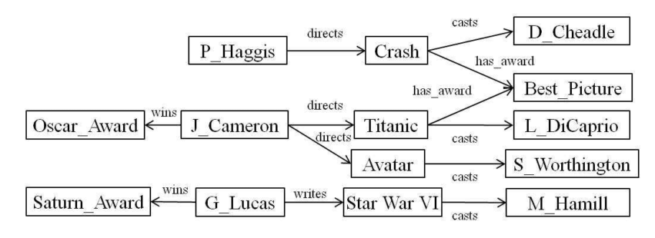
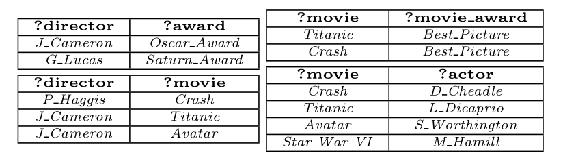
A example RDF graph and the base tables

Slide 15
Join operations
SPARQL query processing consists of two phases
Scan phase: decomposes a SPARQL query into a set of triple patterns. For each triple pattern, we can scan tables or indices to generate bindings.
Join phase: the base tables are joined to produce the final answer to the query.
Limitations of join operations
It uses many costly join operations;
The scan-join process produces large redundant intermediary results;

Slide 16
Graph explorations
Graph exploration can be implemented more efficiently than join, by pruning the unnecessary intermediate results.
However, if the RDF graph is managed by relational tables, triple stores, or disk-based key-value stores, then they need to use join operations. With an index, it usually requires an O(log N) operation. If use native graph, it will perform the same operation in O(1) time.
Trinity.RDF can explore as many as 2.3 million nodes on a graph distributed over an 8-server cluster within one tenth of a second.
However, the order of exploration is important.

Slide 17
System architecture
Trinity.RDF is based on Trinity, which is a distributed in-memory key-value store.
It randomly partitions an RDF graph across a cluster of commodity machines by hashing on the nodes. Each machine holds a disjoint part of the graph.
Given a SPARQL query, they perform search in parallel on each machine.

Slide 18
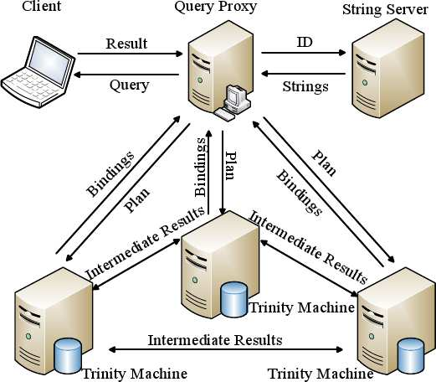
Trinity.RDF Framework
A user submits his query to a proxy.
The proxy generates a query plan and delivers the plan to all the Trinity machines, which hold the RDF data.
Each machine executes the query plan under the coordination of the proxy.
When the bindings for all the variables are resolved, all Trinity machines send back the bindings (answers) to the proxy where the final result is assembled and sent back to the user.

Slide 19
Trinity.RDF Framework
Message passing mechanism
Allow inter-machine
String indexing server
literal-to-id mapping
translates literals in a SPARQL query into ids
id-to-literal mapping
maps ids in the output back to literals for the user.

Slide 20
Graph Partitioning

Slide 21
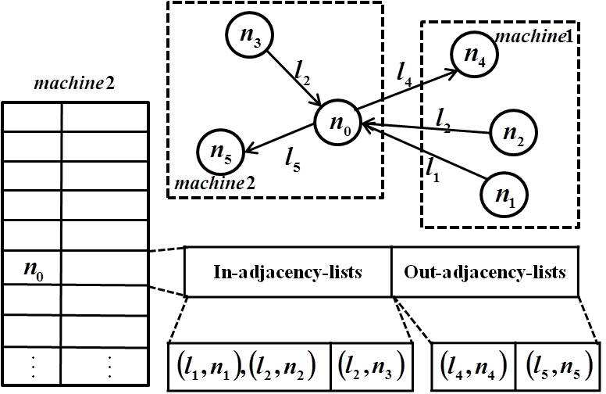
Data model (1)
(node-id, <in-adjacency-list, out-adjacency-list>)
Each element in the adjacency lists is a (predicate, node-id) pair, which records the id of the neighbor, and the predicate on the edge.

Slide 22
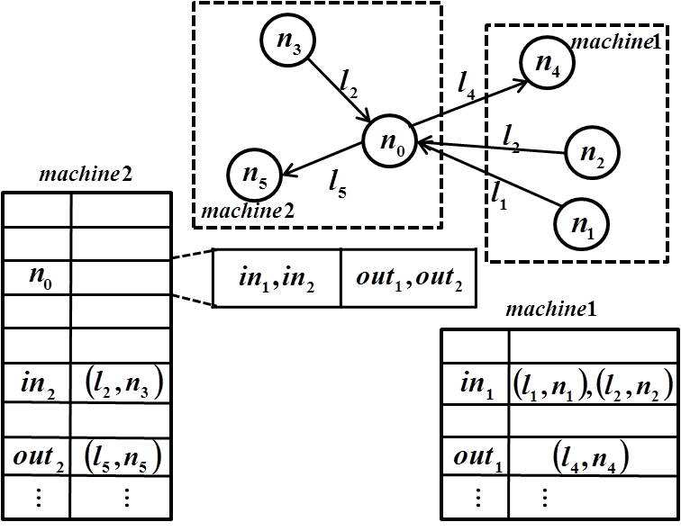
Data model (2)
(node-id, <in₁, …, in_{k}, out₁, …, out_{k}>)
The key-value pair (in, in-adjacency-list) and the nodes in in-adjacency-list are stored on the same machine. That is, we partition the adjacency lists by machine.
Real-life RDF graphs follow the power law distribution. In DBpedia, over 90% nodes have less than 5 neighbors, while some top nodes have more than 100,000 neighbors.

Slide 23
Graph Partitioning strategy
For nodes with few neighbors, model (2) is more costly than model (1), so they use a threshold t to decide which model to use.
If a node has more than t neighbors, they use model (2) to map it to the key-value store; otherwise, they use model (1).

Slide 24
Indexing

Slide 25
Indexing Predicates
Local predicate indexing for each node x
Sort all (predicate, node-id) pairs in x’s adjacency lists first by predicate then by node-id.
Corresponds to SPO or OPS index
Global predicate indexing
Enables to find all nodes that have incoming or outgoing neighbors labeled by a given predicate.
PSO or POS index
For each predicate, machine i stores a key-value pair
(predicate, <subject-list_{i}, object-list_{i}>)

Slide 26
Basic Graph Operators
LoadNodes(predicate, dir)
Return nodes that have an incoming or outgoing edge labeled as predicate.
LoadNeighborsOnMachine(node, dir, i)
For a given node, return its incoming or outgoing neighbors that reside on machine i.
SelectByPredicate(nid, predicate)
From a given partial adjacency list specified by nid, return nodes that are labeled with the given predicate.
dir is a parameter that specifies whether the predicate is an incoming or an outgoing edge.

Slide 27
Query Processing

Slide 28
Query Processing
They represent a SPARQL query Q by a query graph G.
They first decompose Q into an ordered sequence of triple patterns: q₁, …, q_{n}. Then they find matches for each q_{i}, and from each match, they explore the graph to find matches for q_{i+1}.

Slide 29
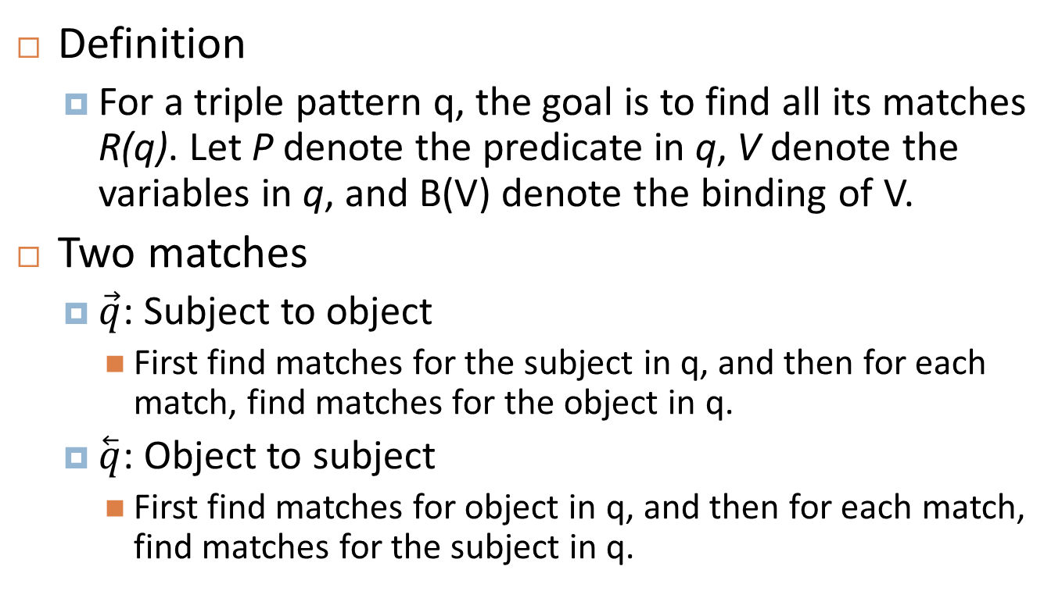
Single Triple Pattern Matching
Definition
For a triple pattern q, the goal is to find all its matches R(q). Let P denote the predicate in q, V denote the variables in q, and B(V) denote the binding of V.
Two matches
$\vec{q}$: Subject to object
First find matches for the subject in q, and then for each match, find matches for the object in q.
$\overset{⃖}{q}$: Object to subject
First find matches for object in q, and then for each match, find matches for the subject in q.

Slide 30
Multiple Pattern Matching
Background
A query consists of multiple triple patterns.
Instead of matching single patterns independently, they treat the query as a sequence of patterns. The matching of the current pattern is based on the matches of previous patterns.
Mechanisms
Exploration plan optimization
Prune intermediate results
A binding is pruned if it cannot reach any bound target, or it cannot be reached from any bound source

Slide 31
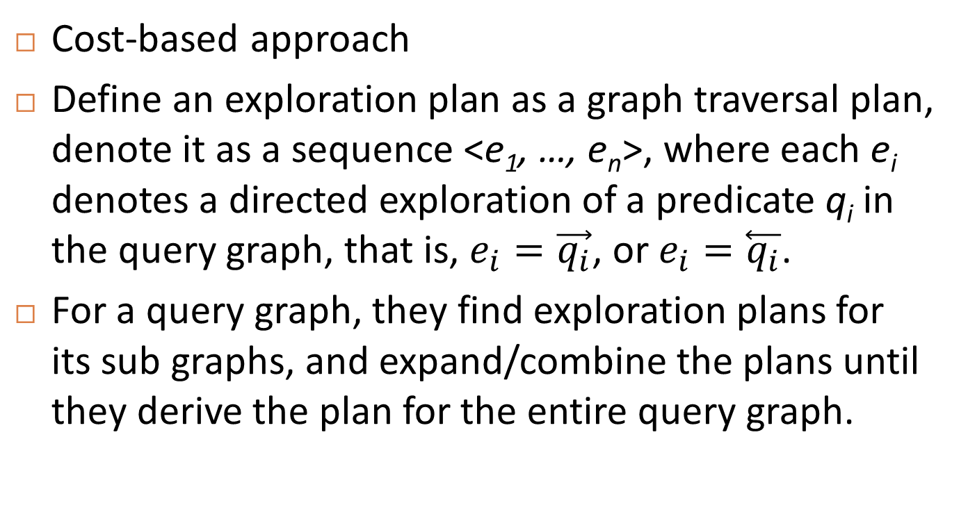
Exploration Plan Optimization
Cost-based approach
Define an exploration plan as a graph traversal plan, denote it as a sequence <e₁, …, e_{n}>, where each e_{i} denotes a directed exploration of a predicate q_{i} in the query graph, that is, $e_{i}=\vec{q_{i}}$, or $e_{i}=\overset{⃖}{q_{i}}$.
For a query graph, they find exploration plans for its sub graphs, and expand/combine the plans until they derive the plan for the entire query graph.

Slide 32
Results

Slide 33
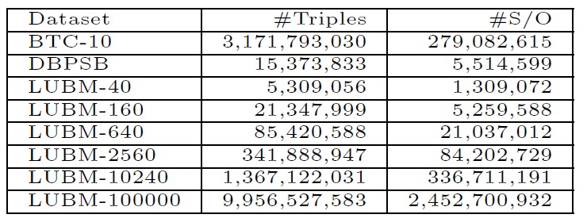
Evaluation
Compare Trinity RDF with
centralized RDF-3X and BitMat
Distributed MapReduce-RDF-3X
Datasets
Real-life dataset
Billion Triple Challenge 2010 dataset
DBPedia’s SPARQL Benchmark (DBPSB)
Synthetic dataset
Lehigh University Benchmark (LUBM)

Slide 34
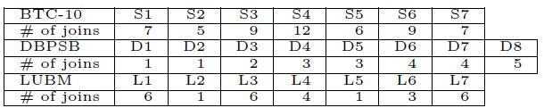
Results
Trinity.RDF outperforms RDF-3X and BitMat.
In-memory architecture
Graph exploration itself is more efficient than join
Trinity.RDF gives surprisingly competitive performance compared to MapReduce-RDF-3X
For some queries, e.g. L4-6, Trinity.RDF is faster
These results become more remarkable because all the LUBM queries are with simple structures
Statistics of queries used in experiments
Notes:
----- 会议笔记(11/4/13 14:46) -----
1. MapReduce-based RDF graph processing 做优化
in-memory + mapreduce
Billion triple challenge
2. scalable fuzzy graph
应用，general problems（具有graph特性）

Slide 35
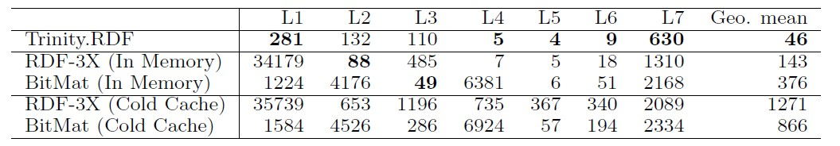
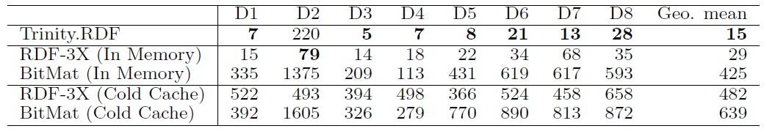
Query run-time in milliseconds on the LUBM-160 dataset (21 million triples)
Query run-time in milliseconds on the DBPSB dataset (15 million triples)

Slide 36
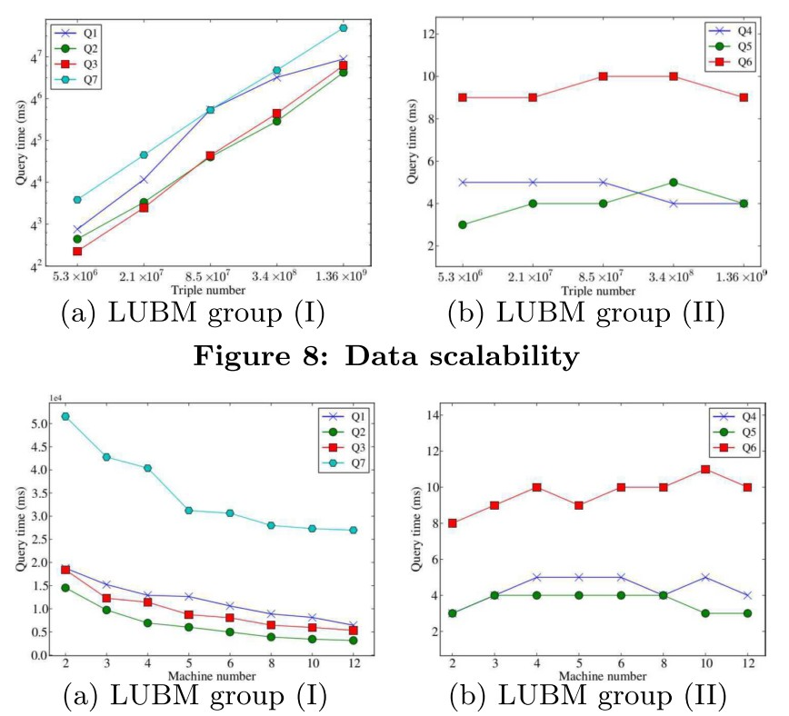

Slide 37
Summary

Slide 38
Lessons
Graph-based mechanisms like Trinity.RDF have great potential for processing and querying graph-like network data.
Inspiration for us
Can be applied to biomedical network data which are obtained and usually maintained by distributed agents
May enable useful and efficient queries

Slide 39
Thanks for your attention!

